Slide 1
Automatic Medicine Reminder Using Arduino

Slide 2
PROJECT MEMBERS
Arshdeep Singh
Dignag Pakhare
Tanushree Suradkar
Umair Khan
Furqan Kazi

Slide 3
CONTENTS : -
INTRODUCTION
BLOCK DIAGRAM
COMPONENTS
CIRCUIT DIAGRAM
WORKING
APPLICATIONS
ADVANTAGES
CONCLUSIONS

Slide 4
INTRODUCTION
Sometimes Patients forget to take medicine at the required time. They also forgets which medicine they have to take. It is impossible to keep tabs on the patient throughout the day.
To overcome this problem we tried to designed a project based on Medicine Reminder. It can remind the patient about the medicine which should be taken on time.
This system consist of Arduino, GSM Module, RTC Module, etc.
This system is driven by an program that inputs is Predefined parameters. The Process is built into the embedded program to initiate the alert through an Audio Alarm.
Not Only does it have an Alarm system but also indicates when the medicine is not taken at the reminded time.

Slide 5
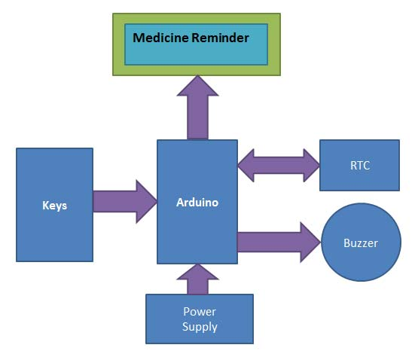
BLOCK DIAGRAM

Slide 6
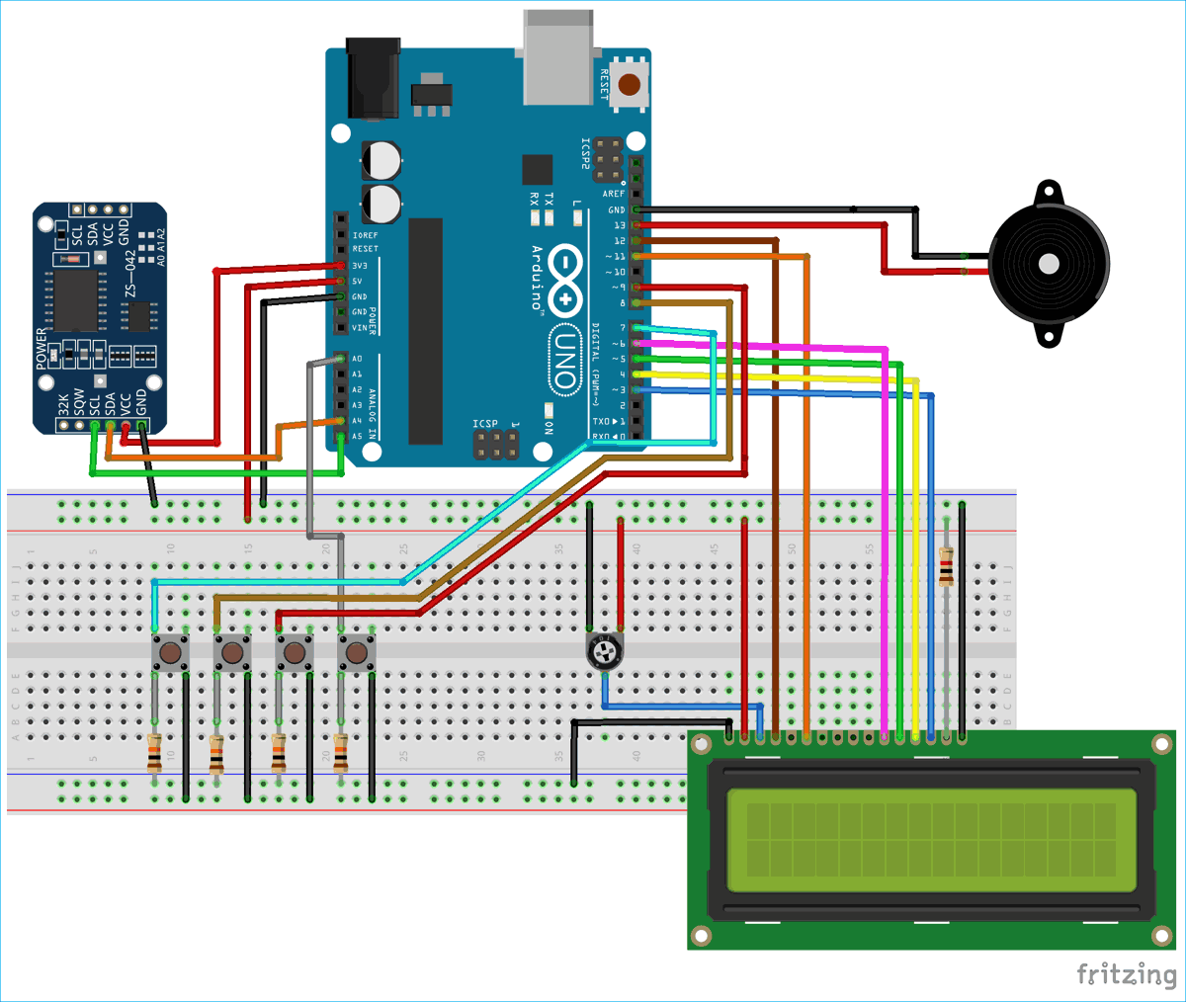
CIRCUIT DIAGRAM

Slide 7
WORKING
The Pill Reminder Alarm is powered using 5V supply. When it first boots up, The LCD screen is set to cycle in three screens. The 1st screen shows massage as “Stay Healthy, Get Well Soon”. The second screen is a help screen which tells to press select push button to select any one time-slot to remind (once/twice/thrice in a day). We have divided time slots into three modes. Mode 1 selects to take medicine once/day at 8am when user presses 1st push button. Mode 2 selects to take medicine twice/day at 8am and 8pm when user presses 2nd push button. Mode 3 selects to take medicine thrice/day at 8am, 2pm and 8pm if user presses 3rd push button. We can also add a feature to snooze the buzzer for 10 minutes (not included in this project). When user selects desired slots by pressing push buttons, the user input is recorded and the time is taken from RTC. When time is matched with selected time slot then the buzzer starts buzzing. User can stop the buzzer by pressing STOP button. The same process continues for the next slot reminder.

Slide 8
COMPONENTS
Arduino UNO
RTC DS3231 Module
16x2 LCD Display
Buzzer
LED
Breadboard
Push Button
10k Potentiometer
10k, 1k Resistors
Jumper Wires

Slide 9
APPLICATIONS
Hospitals
Old Age Homes
Senior Citizens
Alzheimer’s Patients
Medical Fields

Slide 10
ADVANTAGES
Power Saver
Buzz Alarms
Sends Notification on Phone’s and Emails
Can be use through Wifi and Bluetooth
Alerts Patients
Effortless Functions
Automatic

Slide 11
CONCLUSION
The Medicine reminder will be very helpful to many Patients.
It can help to take proper medicine at proper time.
The cost of the production is low as compare to the other problem solution.
The helps the guardian about the Patient if the Medicine is taken or not.

Slide 12
Thank You

